Slide 1
Chapter 16
How to authenticate and authorize users

Slide 2
Objectives (part 1)
Applied
Restrict access to some or all pages of a web app.
Allow users who have registered and logged in to access the restricted pages that they are authorized to access.
Knowledge
Distinguish between authentication and authorization.
Describe how individual user account authentication works.
Describe how to use authorization attributes to restrict access to controllers and actions.
List and describe three properties of the IdentityUser class.
Describe how to add the Identity tables to the DB context class and the database.

Slide 3
Objectives (part 2)
Describe how to add the Identity service to the HTTP request and response pipeline, including how to configure password options.
Describe how to inject a SignInManager<T> object into a layout and use it to add Log In/Out buttons depending on whether the user is currently logged in.
Describe how to inject the UserManager<T>, SignInManager<T>, and RoleManager<T> objects into the Account controller.
Describe how to use the UserManager<T> class to create, update, and delete users.
Describe how to use the SignInManager<T> class to log users in and out.
Define roles and describe how they are used for authorization.
Describe how to use the RoleManager<T> and UserManager<T> classes to work with roles.

Slide 4
Windows-based authentication
Causes the browser to display a login dialog box when the user attempts to access a restricted page.
Is supported by most browsers.
Is configured through the IIS management console.
Uses Windows user accounts and directory rights to grant access to restricted pages.
Is most appropriate for an intranet app.

Slide 5
Individual user account authentication
Allows developers to code a login page that gets the username and password.
Encrypts the username and password entered by the user if the login page uses a secure connection.
Doesn’t rely on Windows user accounts.

Slide 6
Third-party authentication services
Is provided by third parties such as Google, Facebook, Twitter, and Microsoft using technologies like OpenID and OAuth.
Allows users to use their existing logins and frees developers from having to worry about the secure storage of user credentials.
Can issue identities or accept identities from other web apps and access user data on other services.
Can use two-factor authentication.

Slide 7
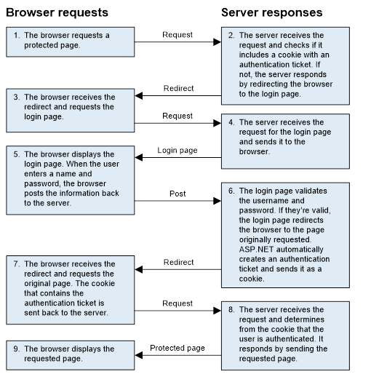
HTTP requests and responses

Slide 8
Some classes provided by ASP.NET Identity
IdentityDbContext
IdentityUser
IdentityRole
UserManager
RoleManager
SignInManager
IdentityResult

Slide 9
Some benefits of Identity
It can be used with all ASP.NET frameworks.
You have control over the schema of the data store that holds user information, and you can change the storage system from the default of SQL Server.
It’s modular, so it’s easier to unit test.
It supports claims-based authentication, which can be more flexible than using simple roles.
It supports third-party authentication providers.
It’s based on OWIN (Open Web Interface for .NET) middleware.
It’s distributed as a NuGet package, so Microsoft can deliver new features and bug fixes faster than before.

Slide 10
Attributes for authorization
AllowAnonymous
Authorize
Authorize(Roles = "r1, r2")
Using directive for the Authorization namespace
using Microsoft.AspNetCore.Authorization;

Slide 11
Only allow logged in users to access an entire controller
[Authorize]
public class CartController : Controller {
...
}
Only allow logged in users in the Admin role to access an entire controller
[Authorize(Roles = "Admin")]
public class BookController : Controller {
...
}

Slide 12
Different attributes for different action methods
public class ProductController : Controller
{
...
[AllowAnonymous]
[HttpGet]
public IActionResult List() {
...
}
[Authorize]
[HttpGet]
public IActionResult Add()
{
...
}
[Authorize(Roles = "Admin")]
[HttpGet]
public IActionResult Delete(int id)
{
...
}
...
}

Slide 13
The NuGet package for Identity with EF Core
Microsoft.AspNetCore.Identity.EntityFrameworkCore

Slide 14
Some properties of the IdentityUser class
UserName
Password
ConfirmPassword
Email
EmailConfirmed
PhoneNumber
PhoneNumberConfirmed

Slide 15
The User entity class
using Microsoft.AspNetCore.Identity;
namespace Bookstore.Models
{
public class User : IdentityUser {
// Inherits all IdentityUser properties
}
}

Slide 16
The Bookstore context class (part 1)
...
using Microsoft.Extensions.DependencyInjection;
using Microsoft.AspNetCore.Identity;
using Microsoft.AspNetCore.Identity.EntityFrameworkCore;
namespace Bookstore.Models
{
public class BookstoreContext : IdentityDbContext<User>
{
public BookstoreContext(
DbContextOptions<BookstoreContext> options)
: base(options) { }
public DbSet<Author> Authors { get; set; }
public DbSet<Book> Books { get; set; }
public DbSet<BookAuthor> BookAuthors { get; set; }
public DbSet<Genre> Genres { get; set; }

Slide 17
The Bookstore context class (part 2)
protected override void OnModelCreating(
ModelBuilder modelBuilder)
{
base.OnModelCreating(modelBuilder);
// BookAuthor: set primary key
modelBuilder.Entity<BookAuthor>()
.HasKey(ba => new { ba.BookId, ba.AuthorId });
...
}
}
}

Slide 18
How to add Identity tables to the database
Start the Package Manager Console (PMC).
Add a migration that adds the tables by entering a command like this one:
Add-Migration AddIdentityTables
Update the database by entering a command like this one:
Update-Database

Slide 19
The Up() method of the generated migration class (part 1)
protected override void Up(MigrationBuilder migrationBuilder)
{
migrationBuilder.CreateTable(
name: "AspNetRoles",
columns: table => new
{
Id = table.Column<string>(nullable: false),
Name = table.Column<string>(maxLength: 256, nullable: true),
NormalizedName =
table.Column<string>(maxLength: 256, nullable: true),
ConcurrencyStamp = table.Column<string>(nullable: true)
},
constraints: table =>
{
table.PrimaryKey("PK_AspNetRoles", x => x.Id);
});

Slide 20
The Up() method (part 2)
migrationBuilder.CreateTable(
name: "AspNetUsers",
columns: table => new
{
Id = table.Column<string>(nullable: false),
UserName = table.Column<string>(maxLength: 256, nullable: true),
NormalizedUserName =
table.Column<string>(maxLength: 256, nullable: true),
Email = table.Column<string>(maxLength: 256, nullable: true),
NormalizedEmail =
table.Column<string>(maxLength: 256, nullable: true),
EmailConfirmed = table.Column<bool>(nullable: false),
PasswordHash = table.Column<string>(nullable: true),
SecurityStamp = table.Column<string>(nullable: true),
ConcurrencyStamp = table.Column<string>(nullable: true),
PhoneNumber = table.Column<string>(nullable: true),
PhoneNumberConfirmed = table.Column<bool>(nullable: false),
TwoFactorEnabled = table.Column<bool>(nullable: false),
LockoutEnd = table.Column<DateTimeOffset>(nullable: true),
LockoutEnabled = table.Column<bool>(nullable: false),
AccessFailedCount = table.Column<int>(nullable: false),
Discriminator = table.Column<string>(nullable: false)
},
constraints: table =>
{
table.PrimaryKey("PK_AspNetUsers", x => x.Id);
});
...

Slide 21
The using directive for the Identity namespace
using Microsoft.AspNetCore.Identity;
How to add the Identity service with default password options
public void ConfigureServices(
IServiceCollection services)
{
...
services.AddIdentity<User, IdentityRole>()
.AddEntityFrameworkStores<BookstoreContext>()
.AddDefaultTokenProviders();
}

Slide 22
Some properties of the PasswordOptions class
RequiredLength
RequireLowercase
RequireUppercase
RequireDigit
RequireNonAlphanumeric

Slide 23
How to configure password options
public void ConfigureServices(
IServiceCollection services)
{
...
services.AddIdentity<User, IdentityRole>(options => {
options.Password.RequiredLength = 6;
options.Password.RequireNonAlphanumeric = false;
options.Password.RequireDigit = false;
}).AddEntityFrameworkStores<BookstoreContext>()
.AddDefaultTokenProviders();
}

Slide 24
How to configure your app to use authentication and authorization
public void Configure(IAppBuilder app, IWebHostEnvironment env)
{
...
app.UseRouting();
app.UseAuthentication();
app.UseAuthorization();
app.UseSession();
...
}

Slide 25
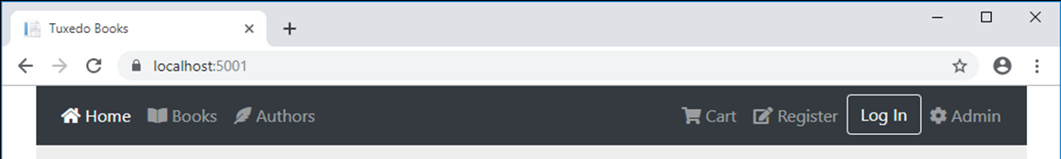
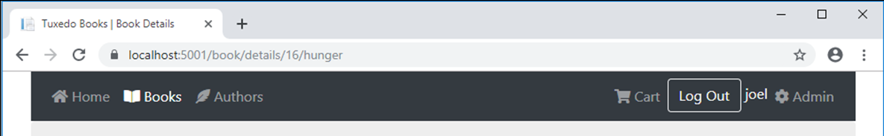
The Register link and Log In button in the navbar
The Log Out button in the navbar

Slide 26
Some of the code for the navbar (part 1)
<!-- Home, Books, Authors, and Cart links go here -->
@using Microsoft.AspNetCore.Identity
@inject SignInManager<User> signInManager
@if (signInManager.IsSignedIn(User))
{
// signed-in user - Log Out button and username
<li class="nav-item">
<form method="post" asp-action="Logout"
asp-controller="Account" asp-area="">
<input type="submit" value="Log Out"
class="btn btn-outline-light" />
<span class="text-light">@User.Identity.Name</span>
</form>
</li>
}

Slide 27
Some of the code for the navbar (part 2)
else
{
// get current action
var action = ViewContext.RouteData.Values["action"]?.ToString();
// anonymous user - Register link and Log In button
<li class="nav-item @Nav.Active("Register", action)">
<a asp-action="Register" asp-controller="Account"
asp-area="" class="nav-link">Register</a>
</li>
<li class="nav-item">
<a asp-action="Login" asp-controller="Account"
asp-area="" class="btn btn-outline-light">Log In</a>
</li>
}
<!-- Admin link goes here -->

Slide 28
Some starting code for the Account controller
using System.Threading.Tasks;
using Microsoft.AspNetCore.Mvc;
using Microsoft.AspNetCore.Identity;
using Bookstore.Models;
namespace Bookstore.Controllers
{
public class AccountController : Controller
{
private UserManager<User> userManager;
private SignInManager<User> signInManager;
public AccountController(UserManager<User> userMngr,
SignInManager<User> signInMngr)
{
userManager = userMngr;
signInManager = signInMngr;
}
// The Register(), LogIn(), and LogOut()methods go here
}
}

Slide 29
The URL that MVC redirects to for an unauthenticated request
/account/login

Slide 30
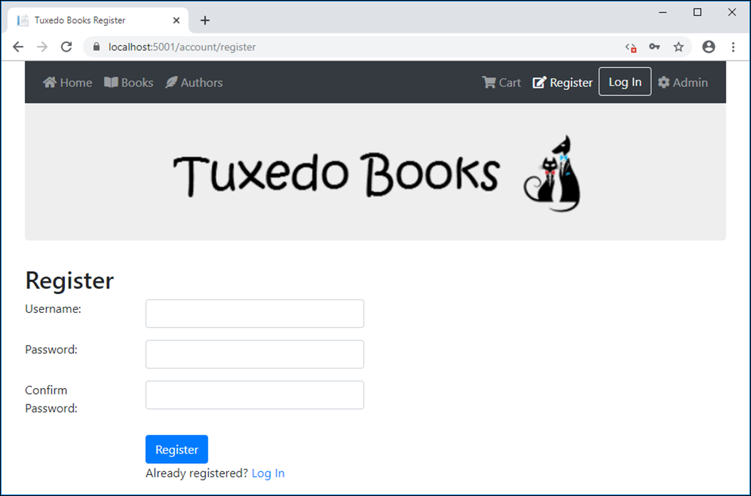
The Register page

Slide 31
The Register view model
using System.ComponentModel.DataAnnotations;
namespace Bookstore.Models
{
public class RegisterViewModel
{
[Required(ErrorMessage = "Please enter a username.")]
[StringLength(255)]
public string Username { get; set; }
[Required(ErrorMessage = "Please enter a password.")]
[DataType(DataType.Password)]
[Compare("ConfirmPassword")]
public string Password { get; set; }
[Required(ErrorMessage = "Please confirm your password.")]
[DataType(DataType.Password)]
[Display(Name = "Confirm Password")]
public string ConfirmPassword { get; set; }
}
}

Slide 32
The Register() action method for GET requests
[HttpGet]
public IActionResult Register()
{
return View();
}

Slide 33
The Account/Register view (part 1)
@model RegisterViewModel
@{
ViewBag.Title = "Register";
}
<h1>Register</h1>
<div asp-validation-summary="ModelOnly" class="text-danger"></div>
<form method="post" asp-action="Register">
<div class="form-group row">
<div class="col-sm-2"><label>Username:</label></div>
<div class="col-sm-4">
<input asp-for="Username" class="form-control" />
</div>
<div class="col">
<span asp-validation-for="Username"
class="text-danger"></span>
</div>
</div>
<div class="form-group row">
<div class="col-sm-2"><label>Password:</label></div>
<div class="col-sm-4">
<input type="password" asp-for="Password"
class="form-control" />
</div>

Slide 34
The Account/Register view (part 2)
<div class="col">
<span asp-validation-for="Password"
class="text-danger"></span>
</div>
</div>
<div class="form-group row">
<div class="col-sm-2"><label>Confirm Password:</label></div>
<div class="col-sm-4">
<input type="password" asp-for="ConfirmPassword"
class="form-control" />
</div>
</div>
<div class="row">
<div class="offset-2 col-sm-4">
<button type="submit" class="btn btn-primary">
Register</button>
</div>
</div>
<div class="row">
<div class="offset-2 col-sm-4">
Already registered? <a asp-action="LogIn">Log In</a>
</div>
</div>
</form>

Slide 35
Three methods of the UserManager class
CreateAsync(user)
UpdateAsync(user)
DeleteAsync(user)
Two methods of the SignInManager class
SignInAsync(user, isPersistent)
SignOutAsync()
Two properties of the IdentityResult class
Succeeded
Errors

Slide 36
The Register() action method for POST requests
[HttpPost]
public async Task<IActionResult> Register(RegisterViewModel model) {
if (ModelState.IsValid) {
var user = new User { UserName = model.Username };
var result = await userManager.CreateAsync(user,
model.Password);
if (result.Succeeded) {
await signInManager.SignInAsync(user,
isPersistent: false);
return RedirectToAction("Index", "Home");
}
else {
foreach (var error in result.Errors) {
ModelState.AddModelError("", error.Description);
}
}
}
return View(model);
}

Slide 37
The LogOut() action method for POST requests
[HttpPost]
public async Task<IActionResult> LogOut() {
await signInManager.SignOutAsync();
return RedirectToAction("Index", "Home");
}

Slide 38
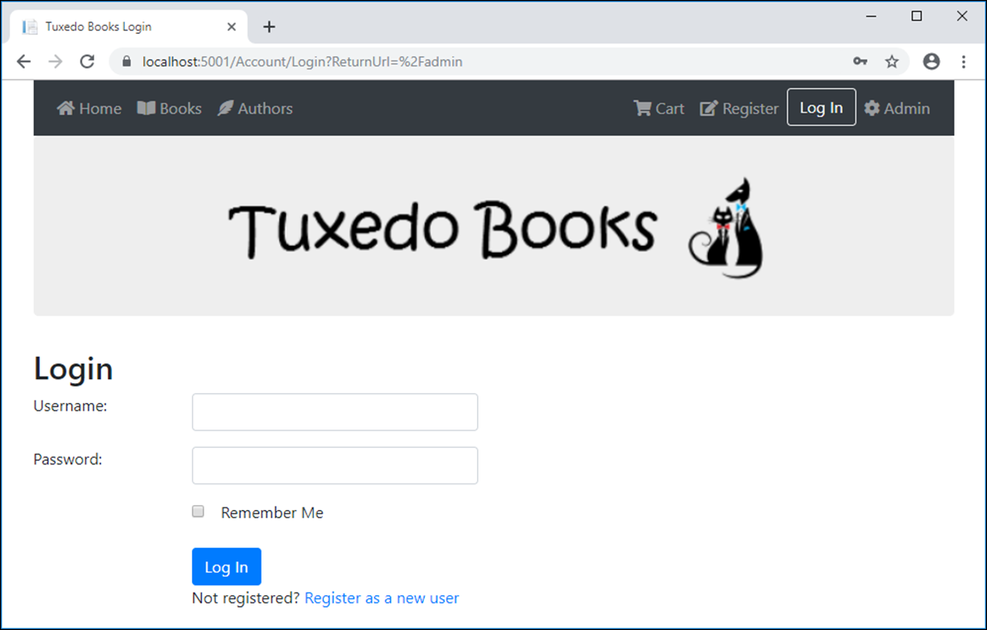
The Login page

Slide 39
The Login view model
using System.ComponentModel.DataAnnotations;
namespace Bookstore.Models
{
public class LoginViewModel
{
[Required(ErrorMessage = "Please enter a username.")]
[StringLength(255)]
public string Username { get; set; }
[Required(ErrorMessage = "Please enter a password.")]
[StringLength(255)]
public string Password { get; set; }
public string ReturnUrl { get; set; }
public bool RememberMe { get; set; }
}
}

Slide 40
The LogIn() action method for GET requests
[HttpGet]
public IActionResult LogIn(string returnURL = "")
{
var model = new LoginViewModel { ReturnUrl = returnURL };
return View(model);
}

Slide 41
The Login view (part 1)
@model LoginViewModel
@{
ViewBag.Title = "Login";
}
<h1>Login</h1>
<div asp-validation-summary="ModelOnly" class="text-danger"></div>
<form method="post" asp-action="LogIn"
asp-route-returnUrl="@Model.ReturnUrl">
<div class="form-group row">
<div class="col-sm-2"><label>Username:</label></div>
<div class="col-sm-4">
<input asp-for="Username" class="form-control" />
</div>
<div class="col">
<span asp-validation-for="Username"
class="text-danger"></span>
</div>
</div>

Slide 42
The Login view (part 2)
<div class="form-group row">
<div class="col-sm-2"><label>Password:</label></div>
<div class="col-sm-4">
<input type="password" asp-for="Password"
class="form-control" />
</div>
<div class="col">
<span asp-validation-for="Password"
class="text-danger"></span>
</div>
</div>
<div class="form-group row">
<div class="offset-sm-2 col-sm-4">
<input type="checkbox" title="Remember Me"
asp-for="RememberMe" class="form-check" />
<label>Remember Me</label>
</div>
</div>

Slide 43
The Login view (part 3)
<div class="row">
<div class="offset-2 col-sm-4">
<button type="submit" class="btn btn-primary">Log In
</button>
</div>
</div>
<div class="row">
<div class="offset-2 col-sm-4">
Not registered?
<a asp-action="Register">Register as a new user</a>
</div>
</div>
</form>

Slide 44
Another method of the SignInManager class
PasswordSignInAsync(username, password, isPersistent, lockoutOnFailure)

Slide 45
The LogIn() action method for POST requests
[HttpPost]
public async Task<IActionResult> LogIn(LoginViewModel model)
{
if (ModelState.IsValid) {
var result = await signInManager.PasswordSignInAsync(
model.Username, model.Password,
isPersistent: model.RememberMe,
lockoutOnFailure: false);
if (result.Succeeded) {
if (!string.IsNullOrEmpty(model.ReturnUrl) &&
Url.IsLocalUrl(model.ReturnUrl))
{
return Redirect(model.ReturnUrl);
}
else
{
return RedirectToAction("Index", "Home");
}
}
}
ModelState.AddModelError("", "Invalid username/password.");
return View(model);
}

Slide 46
A property of the RoleManager class
Roles
Some of the methods of the RoleManager class
FindByIdAsync(id)
FindByNameAsync(name)
CreateAsync(role)
UpdateAsync(role)
DeleteAsync(role)

Slide 47
Another property of the UserManager class
Users
More methods of the UserManager class
FindByIdAsync(id)
FindByNameAsync(name)
IsInRoleAsync(user, roleName)
AddToRoleAsync(user, roleName)
RemoveFromRoleAsync(user, roleName)
GetRolesAsync(user)

Slide 48
Code that loops through all users and their roles
foreach (User user in userManager.Users) {
foreach (IdentityRole role in roleManager.Roles) {
if (await userManager.IsInRoleAsync(user,
role.Name)) {
// perform some processing if user is in role
}
}
}

Slide 49
Code that creates a role named Admin
var result = await roleManager.CreateAsync(
new IdentityRole("Admin"));
if (result.Succeeded) { ... }
Code that deletes a role
IdentityRole role = await roleManager.FindByIdAsync(id);
var result = await roleManager.DeleteAsync(role);
if (result.Succeeded) { ... }

Slide 50
Code that adds a user to the Admin role
User user = await userManager.FindByIdAsync(id);
var result = await userManager.AddToRoleAsync(user,
"Admin");
if (result.Succeeded) { ... }
Code that removes a user from the Admin role
User user = await userManager.FindByIdAsync(id);
var result = await userManager.RemoveFromRoleAsync(user, "Admin");
if (result.Succeeded) { ... }

Slide 51
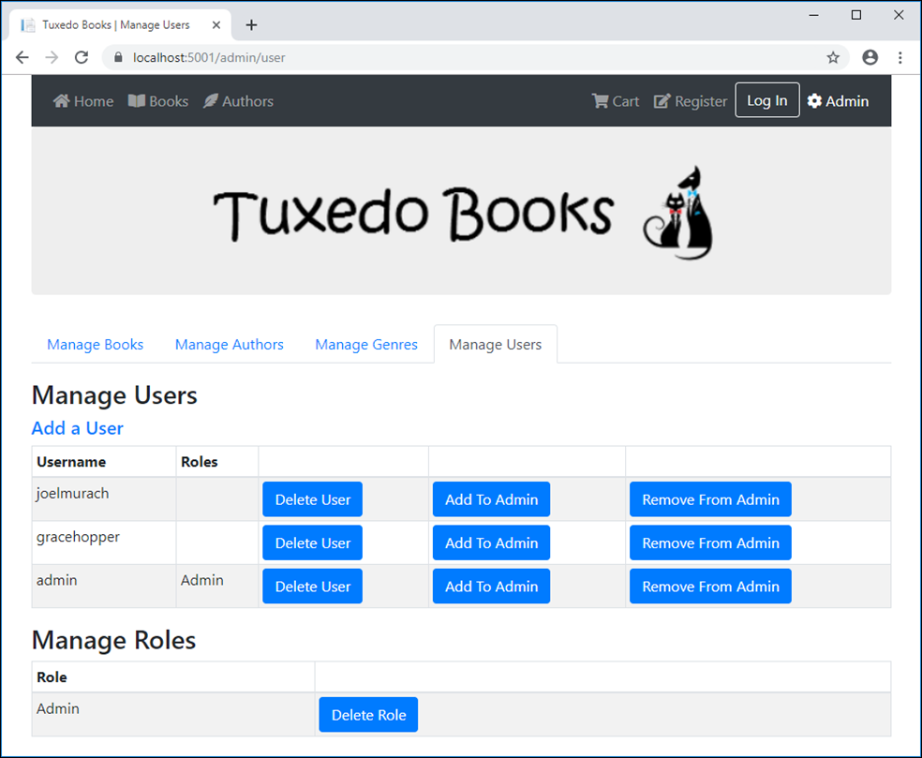
The Manage Users page

Slide 52
The updated User entity
using System.ComponentModel.DataAnnotations.Schema;
...
public class User : IdentityUser
{
[NotMapped]
public IList<string> RoleNames { get; set; };
}

Slide 53
The User view model
public class UserViewModel
{
public IEnumerable<User> Users { get; set; }
public IEnumerable<IdentityRole> Roles { get; set; }
}

Slide 54
The User controller and its Index() action method (part 1)
using System.Threading.Tasks;
using System.Collections.Generic;
using Microsoft.AspNetCore.Mvc;
using Microsoft.AspNetCore.Authorization;
using Microsoft.AspNetCore.Identity;
using Bookstore.Models;
...
[Authorize(Role = "Admin")]
[Area("Admin")]
public class UserController : Controller
{
private UserManager<User> userManager;
private RoleManager<IdentityRole> roleManager;
public UserController(UserManager<User> userMngr,
RoleManager<IdentityRole> roleMngr)
{
userManager = userMngr;
roleManager = roleMngr;
}

Slide 55
The User controller and its Index() action method (part 2)
public async Task<IActionResult> Index()
{
List<User> users = new List<User>();
foreach (User user in userManager.Users)
{
user.RoleNames = await userManager.GetRolesAsync(user);
users.Add(user);
}
UserViewModel model = new UserViewModel
{
Users = users,
Roles = roleManager.Roles
};
return View(model);
}
// the other action methods
}

Slide 56
The User/Index view (part 1)
@model UserViewModel
@{
ViewData["Title"] = " | Manage Users";
}
<h1 class="mb-2">Manage Users</h1>
<h5 class="mt-2"><a asp-action="Add">Add a User</a></h5>
<table class="table table-bordered table-striped table-sm">
<thead>
<tr><th>Username</th><th>Roles</th>
<th></th><th></th><th></th>
</tr>
</thead>
<tbody>
@if (Model.Users.Count() == 0)
{
<tr><td colspan="5">There are no user accounts.</td></tr>
}

Slide 57
The User/Index view (part 2)
else
{
@foreach (User user in Model.Users)
{
<tr>
<td>@user.UserName</td>
<td>
@foreach (string roleName in user.RoleNames)
{
<div>@roleName</div>
}
</td>
<td>
<form method="post" asp-action="Delete"
asp-route-id="@user.Id">
<button type="submit" class="btn btn-primary">
Delete User</button>
</form>
</td>

Slide 58
The User/Index view (part 3)
<td>
<form method="post" asp-action="AddToAdmin"
asp-route-id="@user.Id">
<button type="submit" class="btn btn-primary">
Add To Admin</button>
</form>
</td>
<td>
<form method="post" asp-action="RemoveFromAdmin"
asp-route-id="@user.Id">
<button type="submit" class="btn btn-primary">
Remove From Admin</button>
</form>
</td>
</tr>
}
}
</tbody>
</table>

Slide 59
The User/Index view (part 4)
<h1 class="mb-2">Manage Roles</h1>
@if (Model.Roles.Count() == 0)
{
<form method="post" asp-action="CreateAdminRole">
<button type="submit" class="btn btn-primary">
Create Admin Role</button>
</form>
}
else
{
<table class="table table-bordered table-striped table-sm">
<thead>
<tr><th>Role</th><th></th></tr>
</thead>
<tbody>
@foreach (var role in Model.Roles)
{
<tr>
<td>@role.Name</td>

Slide 60
The User/Index view (part 5)
<td>
<form method="post" asp-action="DeleteRole"
asp-route-id="@role.Id">
<button type="submit"
class="btn btn-primary">Delete Role
</button>
</form>
</td>
</tr>
}
</tbody>
</table>
}

Slide 61
Other action methods of the User controller (part 1)
[HttpPost]
public async Task<IActionResult> Delete(string id)
{
User user = await userManager.FindByIdAsync(id);
if (user != null) {
IdentityResult result =
await userManager.DeleteAsync(user);
if (!result.Succeeded) { // if failed
string errorMessage = "";
foreach (IdentityError error in result.Errors) {
errorMessage += error.Description + " | ";
}
TempData["message"] = errorMessage;
}
}
return RedirectToAction("Index");
}
// the Add() methods work like the Register() methods

Slide 62
Other action methods (part 2)
[HttpPost]
public async Task<IActionResult> AddToAdmin(string id)
{
IdentityRole adminRole =
await roleManager.FindByNameAsync("Admin");
if (adminRole == null) {
TempData["message"] = "Admin role does not exist. "
+ "Click 'Create Admin Role' button to create it.";
}
else {
User user = await userManager.FindByIdAsync(id);
await userManager.AddToRoleAsync(user, adminRole.Name);
}
return RedirectToAction("Index");
}

Slide 63
Other action methods (part 3)
[HttpPost]
public async Task<IActionResult> RemoveFromAdmin(string id)
{
User user = await userManager.FindByIdAsync(id);
await userManager.RemoveFromRoleAsync(user, "Admin");
return RedirectToAction("Index");
}
[HttpPost]
public async Task<IActionResult> DeleteRole(string id)
{
IdentityRole role = await roleManager.FindByIdAsync(id);
await roleManager.DeleteAsync(role);
return RedirectToAction("Index");
}
[HttpPost]
public async Task<IActionResult> CreateAdminRole()
{
await roleManager.CreateAsync(new IdentityRole("Admin"));
return RedirectToAction("Index");
}

Slide 64
Using directive for the Authorization attributes
using Microsoft.AspNetCore.Authorization;
The Cart controller requires users to be logged in
[Authorize]
public class CartController : Controller {
...
}
All controllers in the Admin area require users to be in the Admin role
[Authorize(Roles = "Admin")]
[Area("Admin")]
public class BookController : Controller {
...
}

Slide 65
The AccessDenied() action method of the Account controller
public ViewResult AccessDenied()
{
return View();
}
The code for the Account/AccessDenied view
@{
ViewBag.Title = "Access Denied";
}
<h2>Access Denied</h2>

Slide 66
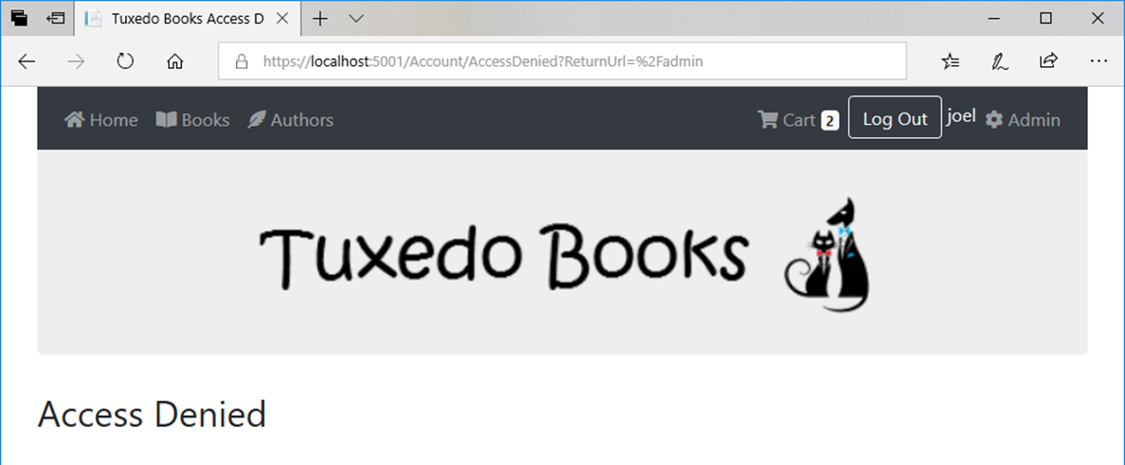
The Account/AccessDenied view

Slide 67
A method added to the DB context class (part 1)
using Microsoft.Extensions.DependencyInjection;
using Microsoft.AspNetCore.Identity;
using Microsoft.AspNetCore.Identity.EntityFrameworkCore;
...
public static async Task CreateAdminUser(
IServiceProvider serviceProvider)
{
UserManager<User> userManager =
serviceProvider.GetRequiredService<UserManager<User>>();
RoleManager<IdentityRole> roleManager = serviceProvider
.GetRequiredService<RoleManager<IdentityRole>>();
string username = "admin";
string password = "Sesame";
string roleName = "Admin";
// if role doesn't exist, create it
if (await roleManager.FindByNameAsync(roleName) == null)
{
await roleManager.CreateAsync(new IdentityRole(roleName));
}

Slide 68
A method added to the DB context class (part 2)
// if username doesn't exist, create it and add it to role
if (await userManager.FindByNameAsync(username) == null)
{
User user = new User { UserName = username };
var result = await userManager.CreateAsync(user, password);
if (result.Succeeded)
{
await userManager.AddToRoleAsync(user, roleName);
}
}
}

Slide 69
A statement in Startup.cs that calls the method
public void Configure(IApplicationBuilder app, IWebHostEnvironment env)
{
// all other configuration statements
BookstoreContext.CreateAdminUser(app.ApplicationServices)
.Wait();
}
An option in the Program.cs file that allows the method to execute
public static IHostBuilder CreateHostBuilder(string[] args) =>
Host.CreateDefaultBuilder(args)
.ConfigureWebHostDefaults(webBuilder =>
{
webBuilder.UseStartup<Startup>()
.UseDefaultServiceProvider(
options => options.ValidateScopes = false);
});

Slide 70
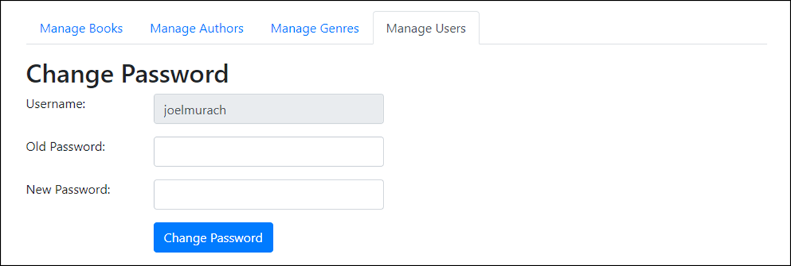
The User/Change Password view

Slide 71
The User/ChangePassword view model
using System.ComponentModel.DataAnnotations;
namespace Bookstore.Models
{
public class ChangePasswordViewModel
{
public string Username { get; set; }
[Required(ErrorMessage = "Please enter password.")]
public string OldPassword { get; set; }
[Required(ErrorMessage = "Please enter new password.")]
[DataType(DataType.Password)]
public string NewPassword { get; set; }
}
}

Slide 72
The ChangePassword() action method for POSTs
[HttpPost]
public async Task<IActionResult> ChangePassword(
ChangePasswordViewModel model)
{
if (ModelState.IsValid)
{
User user =
await userManager.FindByNameAsync(model.Username);
var result = await userManager.ChangePasswordAsync(user,
model.OldPassword, model.NewPassword);
if (result.Succeeded)
{
return RedirectToAction("Index");
}
else
{
foreach (IdentityError error in result.Errors)
{
ModelState.AddModelError("", error.Description);
}
}
}
return View(model);
}

Slide 73
The updated User class
public class User : IdentityUser
{
public string FirstName { get; set; }
public string LastName { get; set; }
[NotMapped]
public IList<string> RoleNames { get; set; };
}

Slide 74
The updated Register view model (part 1)
public class RegisterViewModel
{
[Required(ErrorMessage = "Please enter a username.")]
[StringLength(255)]
public string Username { get; set; }
[Required(ErrorMessage = "Please enter a first name.")]
[StringLength(255)]
public string FirstName { get; set; }
[Required(ErrorMessage = "Please enter a last name.")]
[StringLength(255)]
public string Lastname { get; set; }
[Required(ErrorMessage = "Please enter an email address.")]
[DataType(DataType.EmailAddress)]
public string Email { get; set; } // from IdentityUser class

Slide 75
The updated Register view model (part 2)
[Required(ErrorMessage = "Please enter a password.")]
[DataType(DataType.Password)]
[Compare("ConfirmPassword")]
public string Password { get; set; }
[Required(ErrorMessage = "Please confirm your password.")]
[DataType(DataType.Password)]
[Display(Name = "Confirm Password")]
public string ConfirmPassword { get; set; }
}

